Slide 1

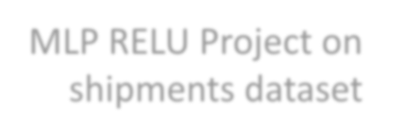
MLP RELU Project on shipments dataset
Pierre Kachi 232732
Rami Chalouhi 221631
Said Chebbo 220700

Slide 2
We used pandas to read the dataset
And then used matplotlib to visualize the initial data:

Slide 3
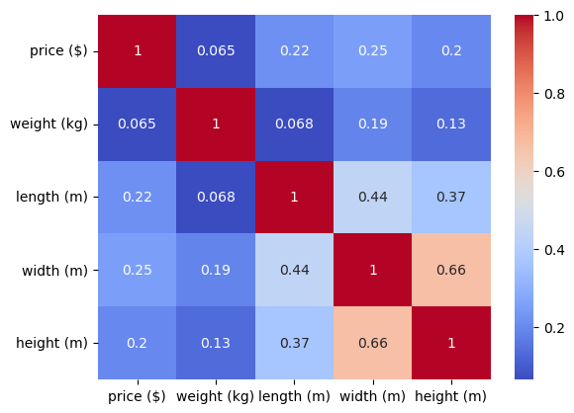

Slide 4
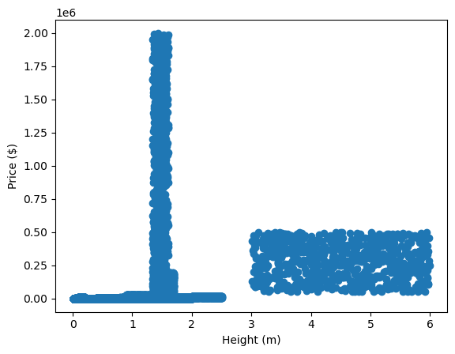
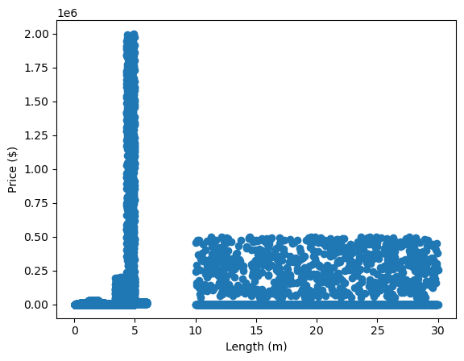

Slide 5
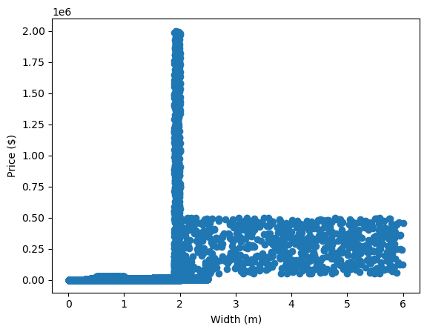
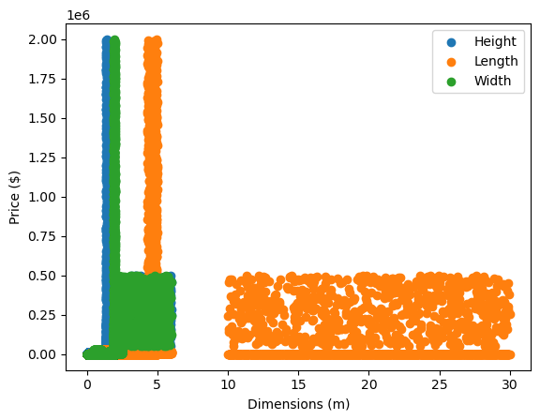

Slide 6
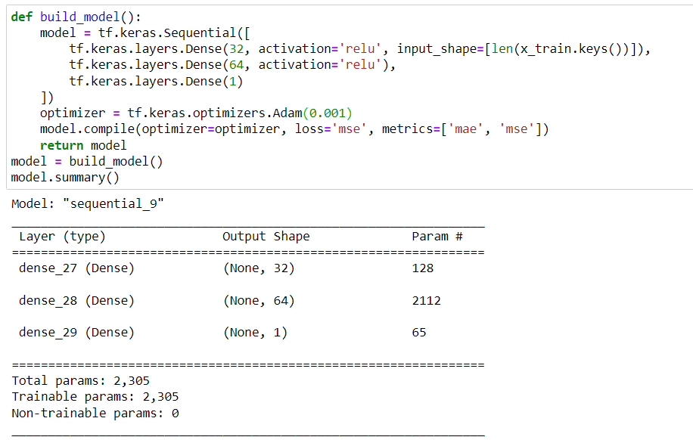
We then proceeded to build the following model:

Slide 7
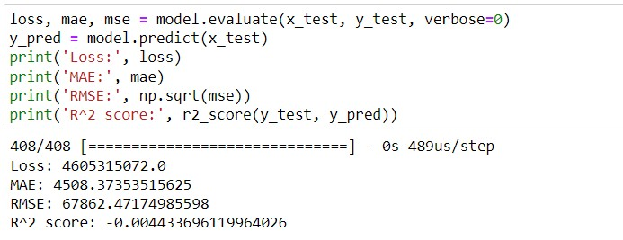
We obtained the following evaluation results:

Slide 8
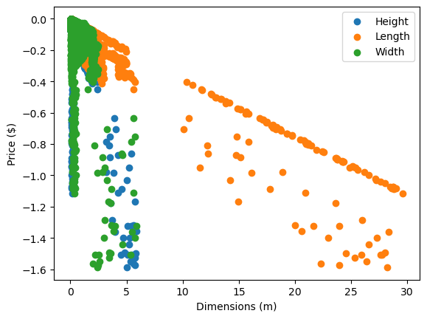
Finally, here is a visualization of the generated data:

Slide 9


Thank you for your time!

